Slide 1
GitHub Tutorial (기초)
2018. 02. 19
Dongyeon Woo

Slide 2
0. Why GitHub?
What?
GitHub is a code hosting platform for version control and collaboration. It lets you and others work together on projects from anywhere.
When?
For individual work / For collaboration
Version control
Enable separate projects (branches)

Slide 3

1. Concept
Repository (저장소)
A repository is usually used to organize a single project. Repositories can contain folders and files, images, videos, spreadsheets, and data sets – anything your project needs.
Remote Repository
(원격저장소)
backup
code sharing
Local Repository
(로컬저장소)
working directory

Slide 4
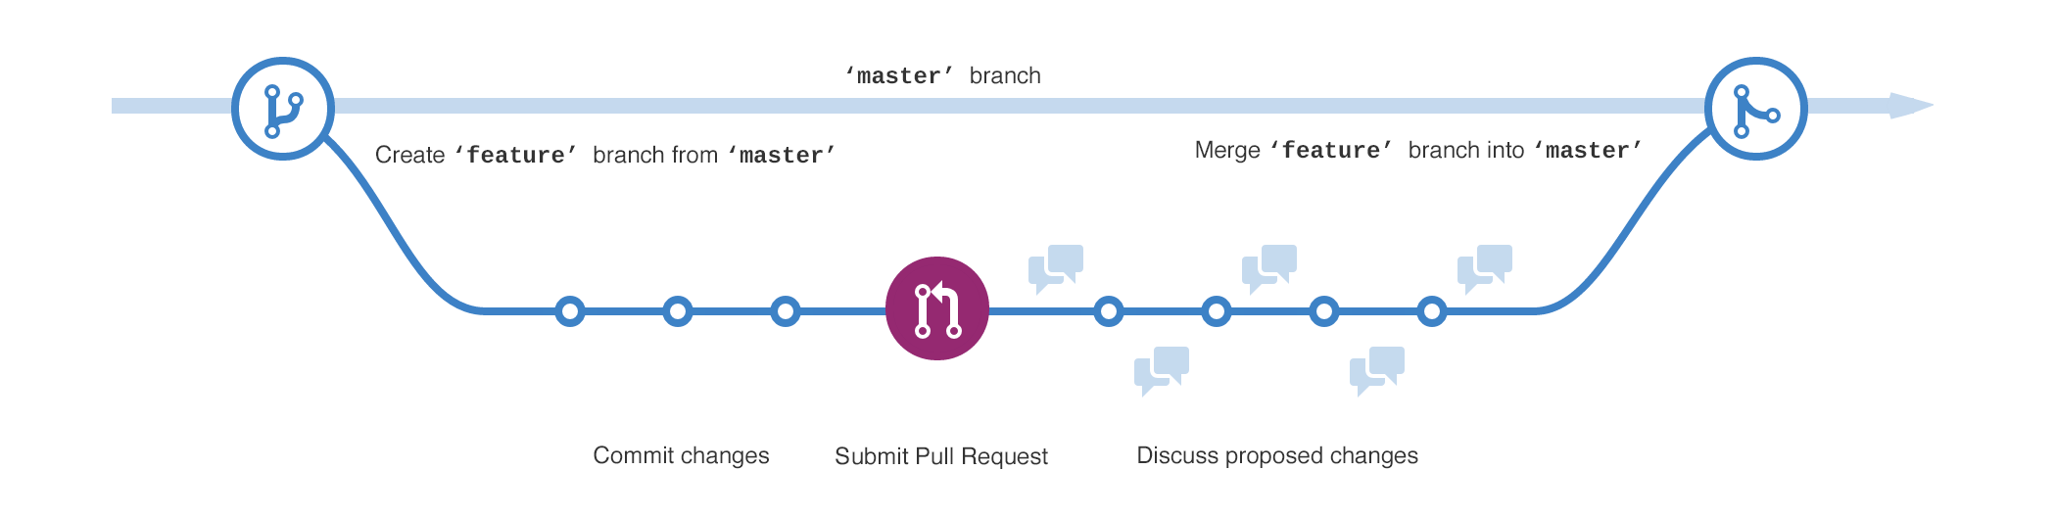
1. Concept
Branch (브랜치)
Branching is the way to work on different versions of a repository at one time
New branches are used for
bug fix
feature work
release branch

Slide 5

1. Concept
Push / Pull
Synchronizing local repository and remote repository
Add / Commit
Confirming code changes
Merge
Merging separate branches into a single code

Slide 6
1. Concept
How it works?
Revising code
Pull (from remote repository) -> Revise code -> Add -> Commit -> Push (to remote repository)
Branching
Pull (target branch) -> Create a new branch -> Coding -> Pull Repuest -> Merge (with existing branch)

Slide 7
2. Function
기본 명령어
git config –global user.name “Your Name Here”
git config –global user.email “your_email@youremail.com”
git init
git clone 복사해올_Git_주소
git branch 새로_생성_브랜치
git checkout 이동_브랜치
git pull
git add 파일_이름
git commit –m “메시지”
git push origin 브랜치_이름

Slide 8
2. Function
추가 명렁어
git fetch
git merge
git branch –b “브랜치”
git remote –v
git remote add
git reset --hard HEAD^
git diff

Slide 9
2. Function
주요 파일
README
Synchronizing local repository and remote repository
.gitignore
Mentioning list of files to be ignored

Slide 10

3. Practice
새 프로젝트 만들기
https://github.com/

Slide 11
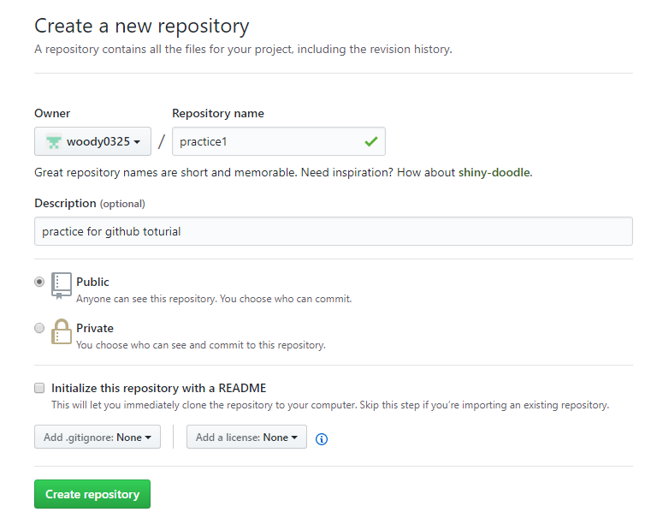
3. Practice
새 프로젝트 만들기

Slide 12
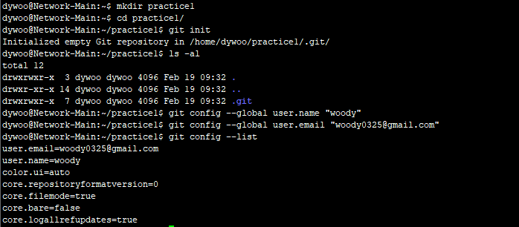
3. Practice
새 프로젝트 만들기

Slide 13
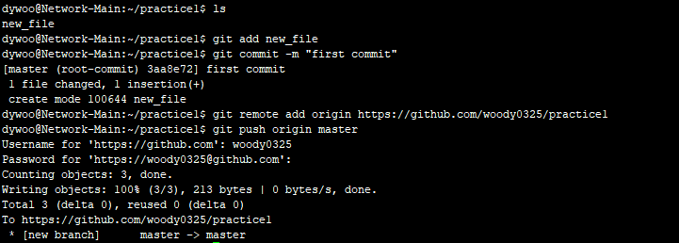
3. Practice
새 프로젝트 만들기

Slide 14
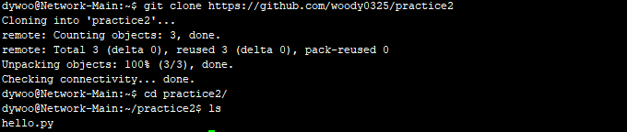
3. Practice
공유 프로젝트 수정하기

Slide 15
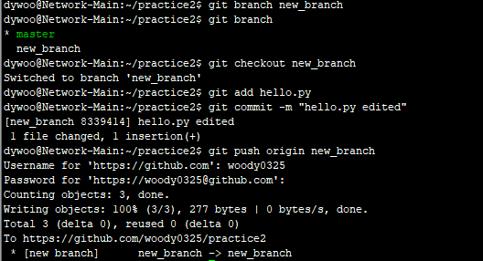
3. Practice
공유 프로젝트 수정하기

Slide 16
4. Reference
참고하면 좋을 자료들
https://guides.github.com/activities/hello-world/
버전관리를 들어본적 없는 사람들을 위한 DVCS – Git https://www.slideshare.net/ibare/dvcs-git?ref=https://nolboo.kim/blog/2013/10/06/github-for-beginner/
Pro GIT https://git-scm.com/book/ko/v2
git 간편안내서 https://rogerdudler.github.io/git-guide/index.ko.html

